Slide 1
Autonomous Detection of Regular Languages
Joel Sommer, Lingjing Huang

Slide 2
Question
Can a Neural Network determine if an input string is “in the language” of the regular language it was trained on?

Slide 3
Objectives
Train the Neural Network on a regular language
Test the Neural Network’s ability to identify whether or not “new” input strings are in the language or not in the language

Slide 4
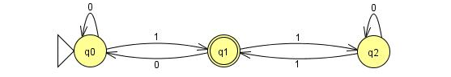
Sample Regular Language
Some strings “in” the language:
1
111
000101
010001

Slide 5
String Generation (Initial Approach)
For each DFA:
Start at the initial state
Randomly transition out of the state
Repeat random transitions until a minimum string length has been met
Check to see if the current state is the terminal state
Check to see if the current string is already in the overall list of strings
Check to see if the current string matches any other DFAs.

Slide 6
Initial Approach
Reuse the RNN Example provided on: https://www.tensorflow.org/tutorials/recurrent
Overall tutorial uses a PTB (Penn Tree Bank) data set
Data set is a large natural language database
PTB example looks at the predicting the next word based on the probability of what has already been

Slide 7
Initial Approach
Natural language doesn’t have the same flow as Automata
Automata need to be able to transition on what are relatively arbitrary data points (compared to natural language)
There may be some sort of way to identify some sort of probabilistic association, but it doesn’t make sense in this context.

Slide 8
Revised Approach
Borrow heavily from:
F. A. Gers and E. Schmidhuber, "LSTM recurrent networks learn simple context-free and context-sensitive languages," IEEE Transactions on Neural Networks, vol. 12, no. 6, pp. 1333-1340, Nov 2001. Overall tutorial uses a PTB (Penn Tree Bank) data set
Gers and Schmidhuber employ “Peephole Connections” and “Forget Gates” to allow for feedback between the Neural Network cells.
Peepholes and Forget Gates are mixed into Constant Error Carousels (CECs)
The CEC in a cell allows the cell to accept and correlate correction from other cells within the neural network.

Slide 9
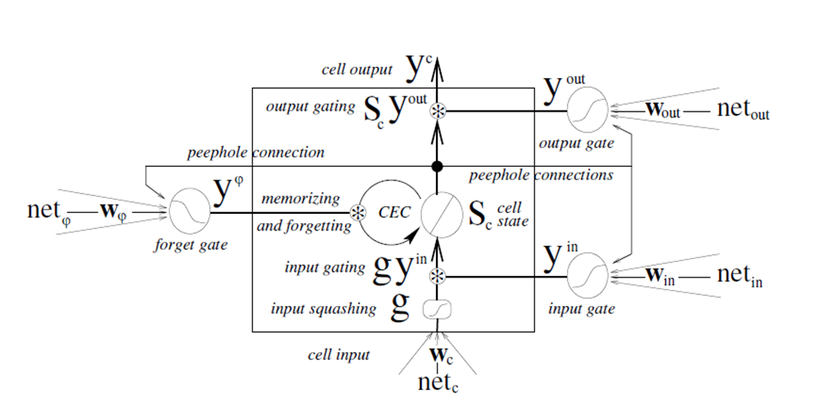
Neural Network Model (Single Cell)

Slide 10
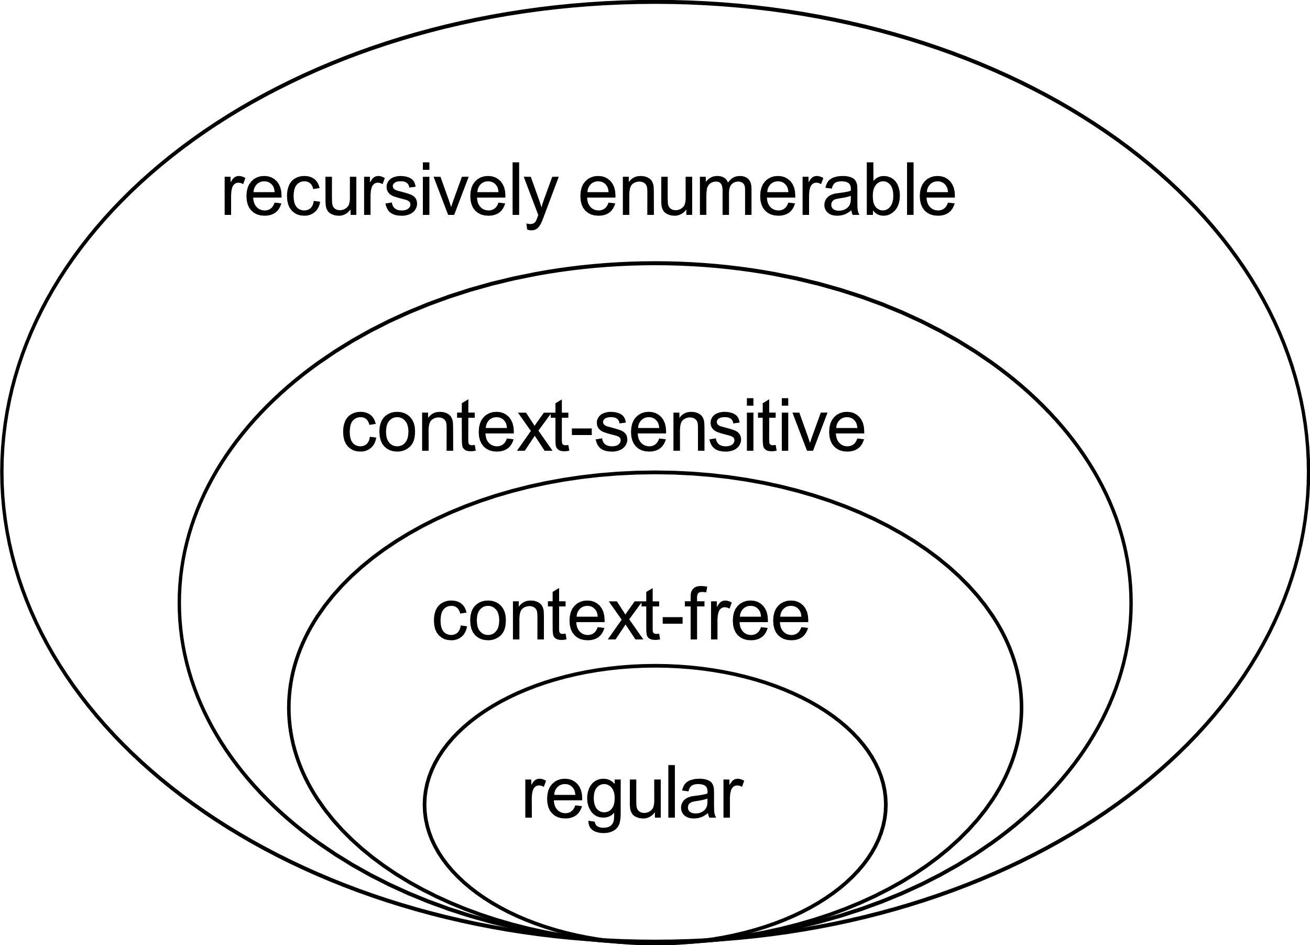
Revised Approach
Gers and Schmidhuber focused on CFL and CSL and found that they were able to have the Neural Net learn the language.
This suggests that there should be no issue with their approach learning a Regular Language
By J. Finkelstein - Own work, CC BY-SA 3.0, https://commons.wikimedia.org/w/index.php?curid=9405226

Slide 11
String Generation (Revised Approach)
Use a 32-bit word as a candidate string. All values from 0x0 – 0xFFFFFFFF were evaluated.
Convert each 32-bit word to a string literal of ones and zeros
Feed string literal to DFA 0. If accepted label as a “valid” string. If not, label as “invalid”.
Save 32-bit words as uint32 data
This approach was taken to remove the variable string length aspect from developing the TensorFlow code.

Slide 12
String Generation (Revised Approach)
For string lengths from 1 to 1000:
Generate a string at random.
Test for “newness” – throw away duplicates.
If accepted by the DFA label and save
If rejected by the DFA label and save.
Once the desired number of strings for a given length has been satisfied, continue to the next string length.
Results is an (n, 1000, 1) array of strings

Slide 13
Results
Initially promising during the proof of concept phase:
~91% accurate when training on one dataset and testing on another
Fixed length strings <= 32 symbols in length
After adding the capability to have variable length inputs:
~85% accurate when training and testing on the same dataset
~50% accurate when testing on “new” data
Training was performed with homogenous string lengths <= 32 symbols in length
Data was structure to support 100 symbol long inputs.

Slide 14
Results
Final results:
Training performed on non-homogenous inputs of 5 – 32 symbols in length.
Samples sized ranged from 100 – 600 samples per string length (where applicable)
Training performed on one dataset – test on another
Training yielded ~85% accuracy with testing yielding ~50% accuracy.

Slide 15
Why so bad?
New to ML.
Didn’t know how to build the model until late in the semester
Even still, learning how to make use of the “right” layers and how to interconnect them.
In this case, it is believed the results were bad because the model was too simple.
Essentially an LSTM Layer connected to an Activation Layer

Slide 16
Questions?

